Slide 1
DTNPL FM
Thermal Vacuum Test
Material Review Board(MRB)
2020. 07. 23

Slide 2
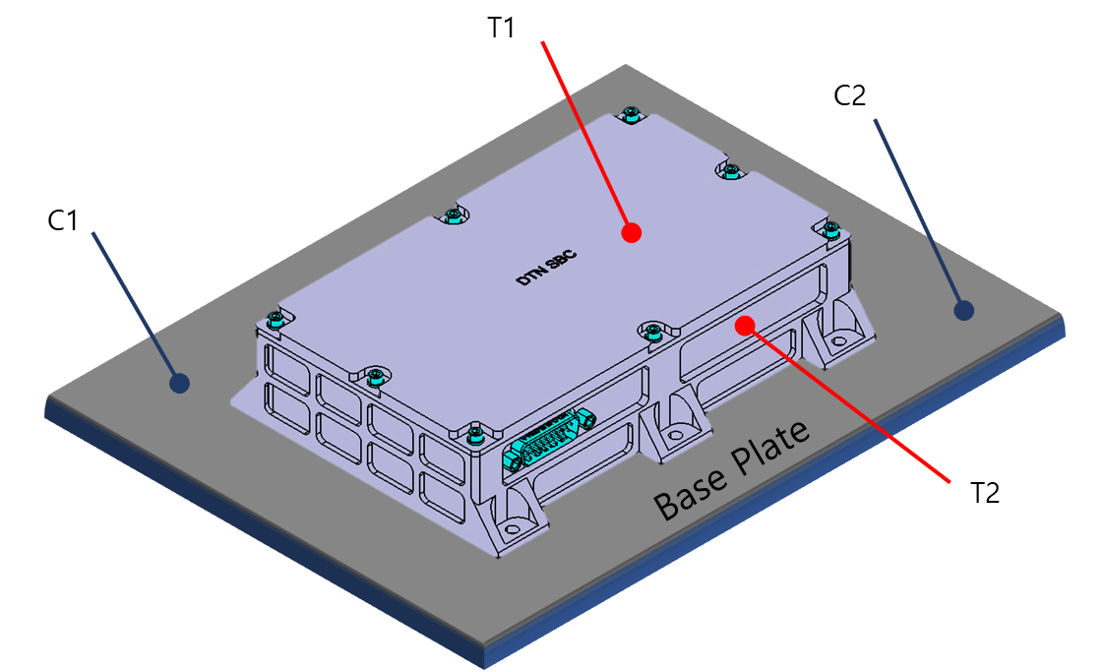
Description
Location of Thermal Sensors
  Control Temperature (@Base Plate)
    C1 (Ch 2-2) : Main
    C2 (Ch2-3) : Optional
  Measurement Temperature :
    T1 (Ch 2-4)
    T2 (Ch 2-5)
Ch 2-4
Ch 2-3
Ch 2-2
Ch 2-5

Slide 3
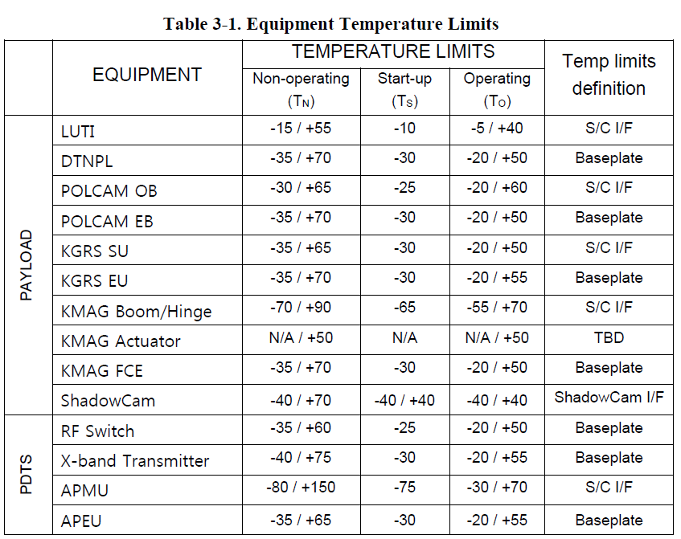
Description
TV Test 온도 조건
  Environmental Design and Test Specification (KPLO-SP-320-002)

Slide 4
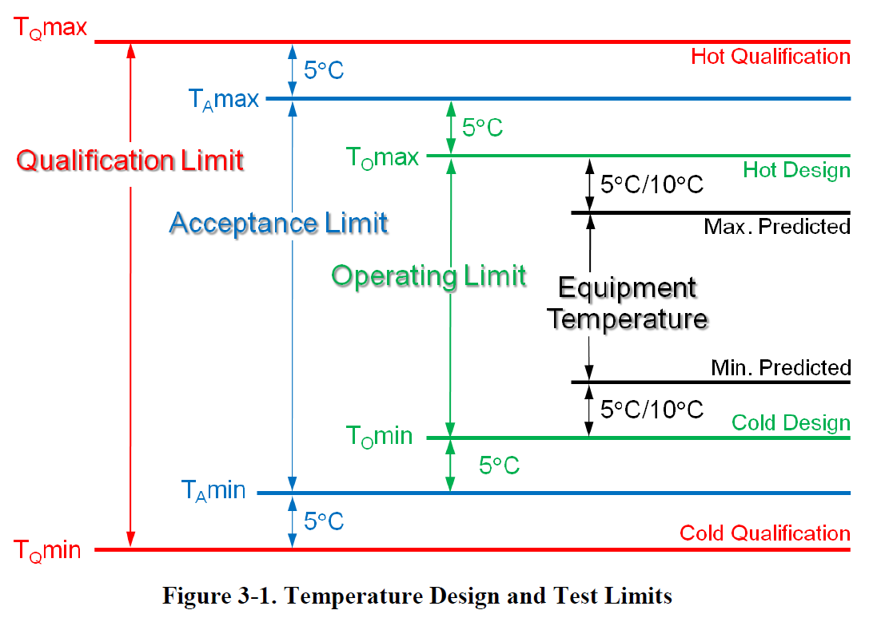
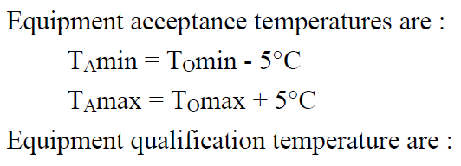
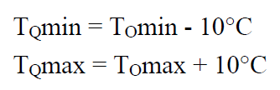
Description
TV Test 온도 조건
  Environmental Design and Test Specification (KPLO-SP-320-002)
  3.1.2 Temperature Extremes

Slide 5
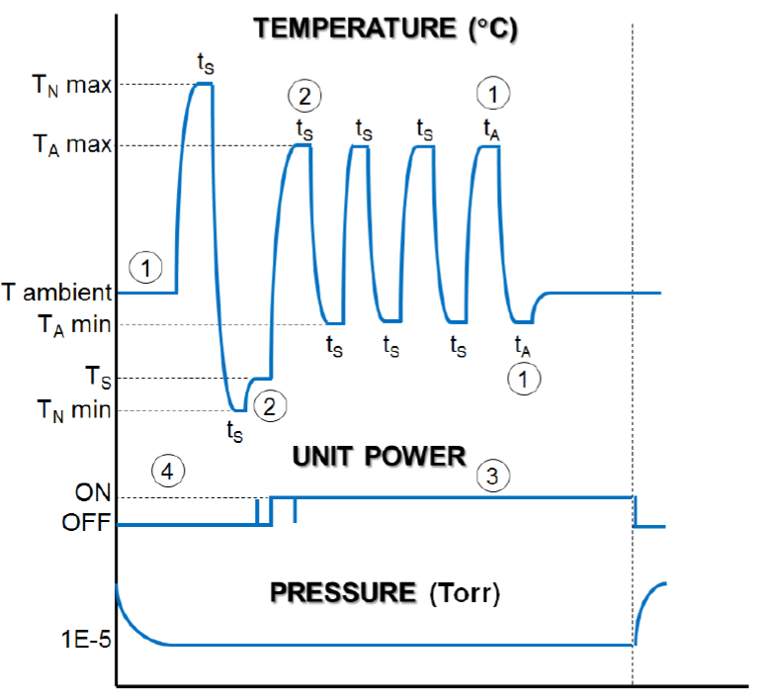
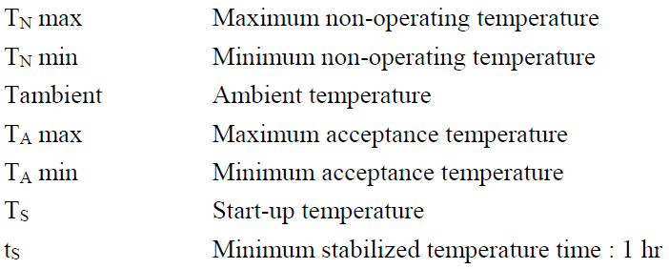
Description
TV Test Temperature Cycling
+70ºC
+55ºC
-25ºC
-30ºC
-35ºC

Slide 6
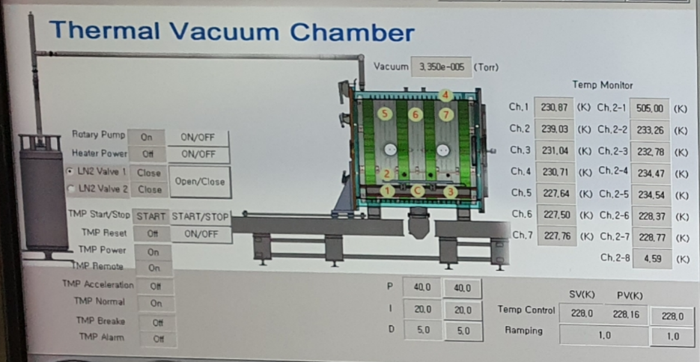
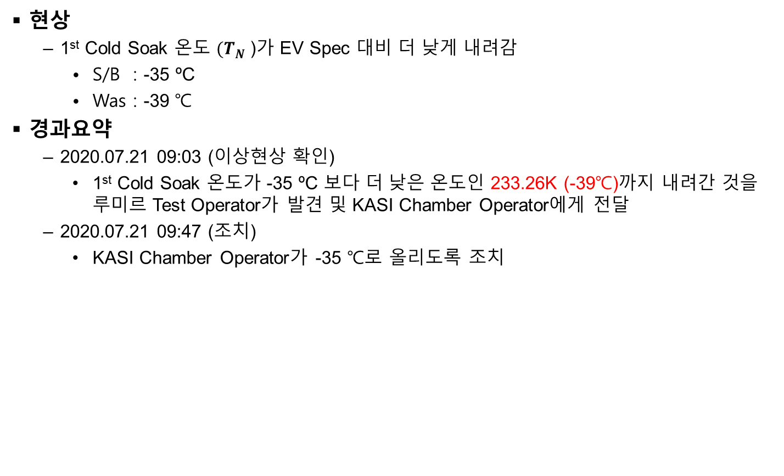
DTNE-NCR-014
현상
  1st Cold Soak 온도 $(T_{N}$)가 EV Spec 대비 더 낮게 내려감
    S/B : -35 ºC
    Was : -39 ℃
경과요약
  2020.07.21 09:03 (이상현상 확인)
    1st Cold Soak 온도가 -35 ºC 보다 더 낮은 온도인 233.26K (-39℃)까지 내려간 것을 루미르 Test Operator가 발견 및 KASI Chamber Operator에게 전달
  2020.07.21 09:47 (조치)
    KASI Chamber Operator가 -35 ℃로 올리도록 조치
233.26K (-39 ℃)시의 Chamber 상황

Slide 7
Issue #1
Root Cause
  KASI Chamber Operator의 챔버 Control 미흡
영향성 분석
  해당 시험은 DTNPL이 OFF된 상태에서 기준 대비 4℃ 더 Cold 충격을 주었으나 H/W에 문제가 생기지는 않았을 것으로 판단함
  사용하는 부품의 Storage Temperate의 경우 마진이 많음 (별첨 참고)
결론
  열진공시험을 계속 진행하는 것으로 협의함
  KASI Chamber Operator에게 주의를 줌
+70ºC
+55ºC
-25ºC
-30ºC
-35ºC
-35 ℃ 이어야 하나
-39.89℃ 로 Cold Soak

Slide 8
(별첨) DTNPL FM 부품의 Storage Temperature
사용하는 부품 15종 모두 Storage Temperature가 -55 ℃까지는 가능함
  수행되었던 1st Cold Soak 온도인 -39℃에서 부품의 Damage 없음
Item No. | Part Number (FM) | Function Characteristics | Generic Procurement Specification | Detail Procurement Specification | Manufacturer/ Country | Quality Level (FM) | Storage Temperature Range
1 | 3DFN32G08VS4704 MS | IC, Module, NAND Flash, 32Gbit (4G x 16), 3.3V | MIL-PRF-38535 | 3DPA-6800-1 | 3D PLUS | Class V.eq | -65~150
2 | 3DSD2G40VS5493 SS | IC, Module, Memory, SDRAM, 2Gbit, 3.3V | MIL-PRF-38535 | 3DPA-4760-3 | 3D PLUS | Class V.eq | -55~150
3 | 3DMR64M08VS4476 SS | IC, Module, Memory, MRAM, 3.3V | MIL-PRF-38535 | 3DPA-4620-03 | 3D PLUS | Class V.eq | -55~125
4 | 5962R0722701VFA | IC, Linear, 12-Bit A/D Converter, 8-Channel, 50kSPS to 1MSPS | MIL-PRF-38535 | MIL-PRF-38535 | Texas Instrument | QML V | -65~150
5 | 5962F07A0501VXC | IC, Linear, QUAD HIGH SPEED DIFFERENTIAL RS422 LINE DRIVER | MIL-PRF-38535 | MIL-PRF-38535 | Honeywell | QML V | -65~150
6 | 5962F07A0401VXC | IC, Linear, QUAD HIGH SPEED DIFFERENTIAL RS422 LINE RECEIVER | MIL-PRF-38535 | MIL-PRF-38535 | Honeywell | QML V | -65~150
7 | 3DLV3302VS1619 MS | IC, Linear, Dual LVDS Driver and Receiver, 3.3V | MIL-PRF-38535 | MIL-PRF-38535 | 3D PLUS | QML V.eq | -65~150
8 | 5962R8551401VPA | IC, Linear, Precision voltage refence, 5V | MIL-PRF-38535 | MIL-PRF-38535 | Analog Devices | QML V | -65~150
9 | 5962R9950402VDA | IC, Linear, Quad Operational amplifier | MIL-PRF-38535 | MIL-PRF-38535 | Texas Instrument | QML V | -65~150
10 | MSK5063HRH | Hybrid, Linear, RAD HARD, Positive Voltage Regulator, ADJ, 10A | MIL-PRF-38535 | 8218.1 Rev.B | MSK | Class H.eq | -65~150
11 | 5962R1320202VXC | Hybrid, Linear, RAD HARD, Positive Voltage Regulator, ADJ, 3A | MIL-PRF-38535 | MIL-PRF-38535 | Texas Instrument | Class K.eq | -55~150
12 | 3DPM0168-2-SS | Latch-Up Current Limiter, 2A | MIL-STD-883 | MIL-STD-883 | 3D PLUS | Class K.eq | -55~150
13 | 5962-1620801QXF | IC, Digital, FPGA, RT4G, Radiation Tolerant | MIL-STD-883 | WP0194, MIL-STD-883/VQC-12-024083 | MICROSEMI | MIL-STD-883B | -55~125
14 | XE64S-L43-40.000MHz | Hybrid, Crystal Oscillator, Class-2, 40MHz, 3.3V, HC/ACMOS Sq Wave Output | MIL-PRF-55310 | OS-68338 | XSIS | Class S.eq | -55~125
15 | JANS2N2222AUB | NPN Silicon Switching Transistor | MIL-PRF-19500/255 | MIL-PRF-19500/255 | Microsemi | JANS | -65~200

